Slide 1

STOCK AND SHIPPING dATA ANALYST
KENNETH VINCENTIUS
01

Slide 2
bACKGROUND
I have been tasked by an e-commerce company to perform an analysis of their "Shipping and Stock Performance Review for Q1 - Q2 2023." This comprehensive analysis aims to evaluate and provide insights into the company's performance in terms of shipping logistics and stock management during the first two quarters of the year 2023.
pROBLEM sTATEMENT
To make the e-commerce company's shipping and stock processes better in the first half of 2023 and suggest improvements to the management in next 6 months.
02

Slide 3
Step
Take data from Google Big Query using SQL and save it to CSV
Load the CSV data
Do data cleaning (change data type, handling missing value)
Exploratory Data Analyst
Make conclusion
Save data that has been cleaned and processed
Make Visualization in Tableau
03

Slide 4
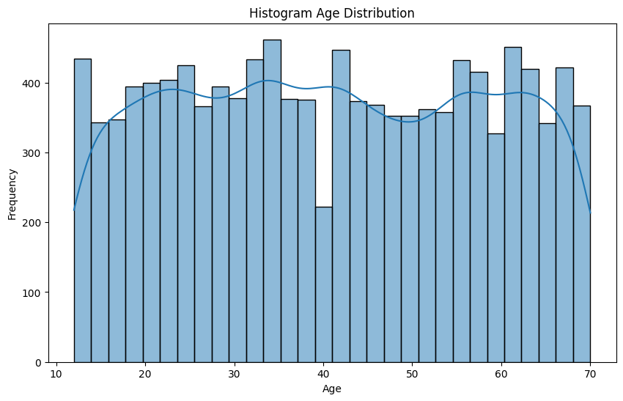
EXPLORATORY DATA ANALYST
Results:
If we see that the age distribution of customers is dominated by adults aged 20-40 who are in their productive age
Insight :
The selection of products in stock that is large can be considered based on the age of the customers who buy the most to avoid death stock
04

Slide 5
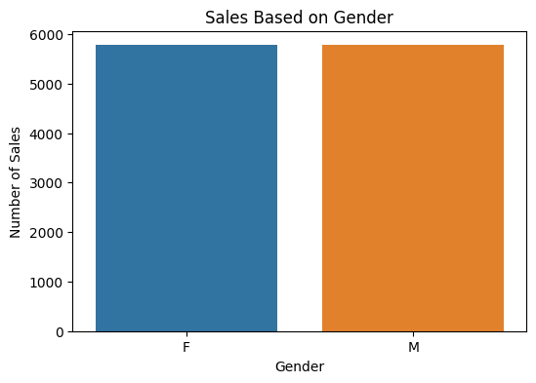
EXPLORATORY DATA ANALYST
Results:
The numbers for men and women are not too different so knowing which products are popular among men and women can help in targeting promotions and arranging stock.
Insights:
The product with the highest sales is from the Allerga K brand, which is a brand for women, so the company increases stock and promotions for this product in the women's market segment compared to men's products
05

Slide 6
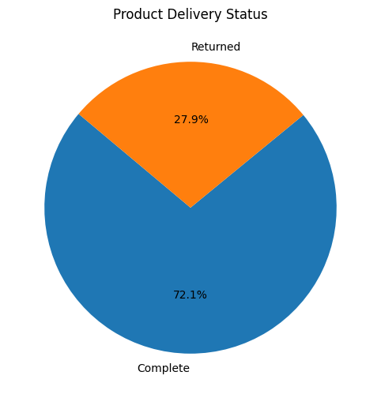
EXPLORATORY DATA ANALYST
Results:
It can be seen that the percentage rate of returned goods is quite high at 27.9%
Insights:
If there is a high return rate, this could be an indicator of a product quality problem or a mismatch in customer expectations. Businesses should evaluate quality control processes and may need to improve product descriptions to reduce returns
06

Slide 7
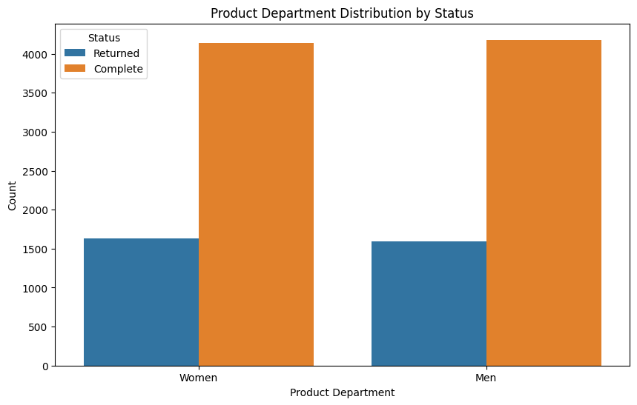
EXPLORATORY DATA ANALYST
Result:
It is observed that the delivery status comparison between women and men is not significantly different.
Insight:
Given the similar delivery status between women and men, companies can seize this opportunity to enhance their delivery services by focusing on speed, efficiency, and reliability, which are important factors for all customers. Furthermore, developing a loyalty program or special offers that appeal to all customer segments can boost customer retention and drive increased sales.
07

Slide 8
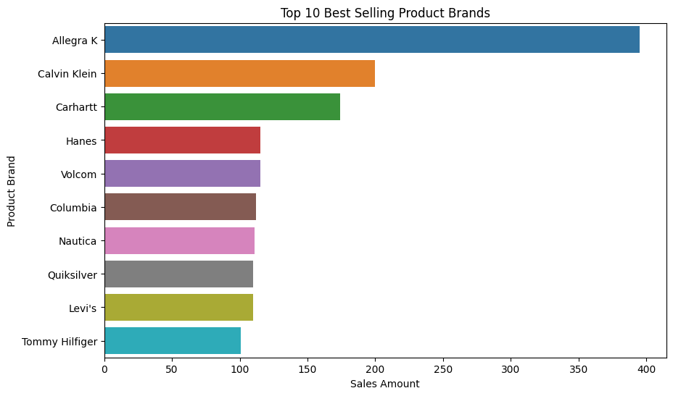
EXPLORATORY DATA ANALYST
Results:
It can be seen that the brand above has a high level of sales compared to other brands
Insight :
Companies can carry out larger stocks of goods from the brands above, especially Allegra R, Calvin Klein, and Carharrt so they can get cheaper purchasing prices to increase profits by buying more of the brands with the highest sales.
08

Slide 9
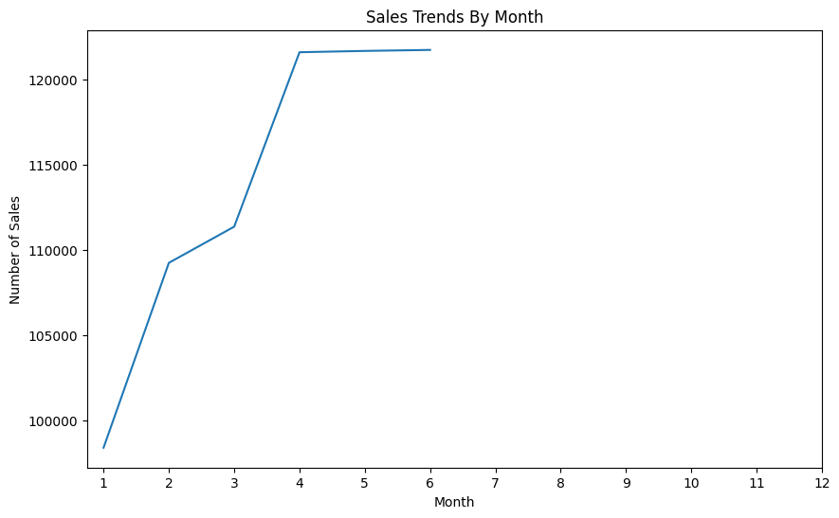
EXPLORATORY DATA ANALYST
Results:
The highest sales are from April to June, which is the month of Eid and getting holiday allowence
Insights:
Companies can prepare more stock during that month and ensure deliveries run smoothly by increasing the number of couriers to avoid complaints and returns due to long deliveries.
09

Slide 10
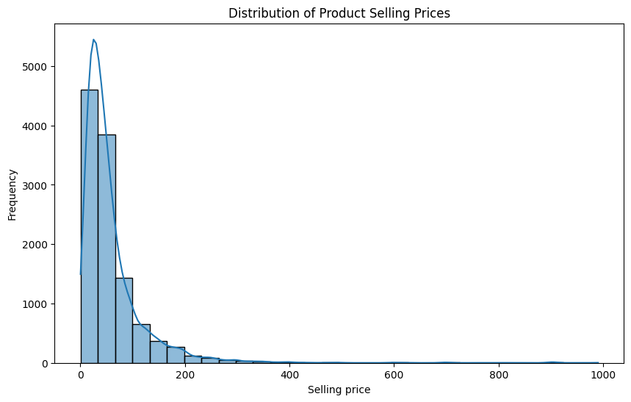
EXPLORATORY DATA ANALYST
Results:
goods with low prices are purchased more often than those with high prices
Insights:
Companies can focus their stock more on goods with lower prices than high prices to avoid unsold goods because the frequency of purchasing low goods is higher than goods with high prices
10

Slide 11
Statistic Descriptive
Age
Average Age of Customer: 40.90048501645592
Median Age of Customer: 41.0
Modus Age of Customer: 0 34
Skewness Age of Customer:: 0.01713877583170625
Result:
The average customer age is around 41 years, with the most common age being 34. The age distribution is nearly symmetrical, indicating a customer base that spans a wide range of ages, but is centered around middle-aged adults.
Insight:
Given the age profile of the customers, it's beneficial for the business to focus on products and marketing strategies that appeal to middle-aged adults, while also considering the preferences of customers in their early thirties. Offering a variety of products that cater to this diverse age group could maximize customer reach and satisfaction.
11

Slide 12
Statistic Inferencial
Calculates the relationship between status and delivery_duration
H0 = There is no significant relationship between status and delivery_duration
H1 = There is a significant relationship between status and delivery_duration
Significance level = 0.05
If the p-value <- 0.05, then H0 is rejected
If the p-value is >0.05, then H0 cannot be rejected
The statistical correlation between delivery status and delivery duration resulted in a correlation value of -0.0086 and a p-value of 0.354.
The very small correlation value (-0.0086) indicates that there is almost no significant linear relationship between the delivery status and the duration of delivery. This means that the length of time a delivery takes does not significantly affect whether the delivery will be successful or returned.
Furthermore, a p-value higher than 0.05 suggests that this relationship is not statistically significant. Therefore, based on this data, it can be concluded that there is no significant correlation between the duration of delivery and whether the delivery is successful or not, then H0 cannot be rejected
12

Slide 13
conclusion
To optimize stock and sales, the business should prioritize products that appeal to middle-aged adults and those in their early thirties, focusing on popular brands like Allegra R, Calvin Klein, and Carhartt. High return rates need addressing, potentially indicating quality or expectation mismatches, and more emphasis should be placed on women's products, particularly from the Allegra K brand. It's also beneficial to stock more affordable items, as they tend to sell more frequently, delivery duration does not significantly impact delivery success.
Link Tableau
Dashboard: https://public.tableau.com/app/profile/kenneth.vincentius/viz/ShippingandStockDataVisualization/Dashboard?publish=yes
Story Telling : https://public.tableau.com/app/profile/kenneth.vincentius/viz/ShippingandStockDataVisualization/Story1?publish=yes
13

Slide 14
Thank you
14

